Slide 1
Secure Data Hiding In Images Using Steganography
CAPSTONE PROJECT
Presented By: Kapish Juneja
Student Name : Kapish Juneja
College Name & Department : Lovely Professional University (MCA)

Slide 2
OUTLINE
Problem Statement
Technology used
Wow factor
End users
Result
Conclusion
Git-hub Link
Future scope

Slide 3
Problem Statement
In today's hyper-connected world, sharing sensitive information via text or messaging apps has become a routine part of daily life, yet it carries significant risks of data leaks. Whether it's personal details or confidential business communications, the potential for unauthorized access and exposure is ever-present.
The convenience of instant messaging often overshadows the lurking threat of breaches, leaving individuals and organizations vulnerable. Addressing this problem requires innovative approaches to enhance security and protect our digital conversations from prying eyes.

Slide 4
Technology used
Platforms Supported/Used:
Windows/MacOS/Linux
Requirements:
Python 3.x
Tkinter
PIL
Libraries used:
Tkinter (tk)
Pillow from PIL (Python Image Library)
Filedialog
Messagebox

Slide 5
Wow factors
Multi-Format Support: While many steganography projects focus on images, extending support to other media types like audio or video can significantly enhance the project's appeal. This versatility shows a more comprehensive understanding of data hiding methods.
Robust Encryption: Adding an encryption layer before embedding data can increase security. Combining steganography with encryption ensures that even if someone detects the hidden data, they can't easily decipher it.
User-Friendly Interface: Designing a sleek, intuitive user interface, perhaps using frameworks like Tkinter or PyQt, can make your project accessible to those without technical expertise. This could involve drag-and-drop functionality for files, making it appealing and easy to use.
Real-Time Processing: Implementing real-time data hiding and extraction can make your project stand out. Users can see instantaneous results, which can be particularly impressive with video or audio files.
Error Detection and Correction: Introducing features for detecting and correcting errors in the embedded data can make your project more robust. This ensures data integrity even if the carrier file undergoes slight modifications.
Steganalysis Resistance: Developing techniques to resist common steganalysis methods, which are used to detect hidden messages, can elevate your project. This involves disguising patterns that might otherwise reveal the presence of concealed data.
Educational Integration: Including educational components like interactive tutorials or detailed documentation can set your project apart. This aspect can be valuable for students and educators looking to understand the concepts behind steganography.
Cross-Platform Compatibility: Ensuring that your project runs smoothly on different operating systems (Windows, macOS, Linux) can broaden its usability and appeal.

Slide 6
End users
Cybersecurity Professionals: They can use steganography for secure communication, ensuring sensitive information is hidden within innocuous files to prevent interception by unauthorized parties.
Journalists and Whistleblowers: This technology can help in securely transmitting sensitive information without raising suspicion, especially in regions with strict censorship.
Law Enforcement and Intelligence Agencies: These organizations might use steganography for covert communication in intelligence operations, ensuring messages remain hidden from adversaries.
Artists and Digital Creators: Artists can embed metadata or copyright information within their digital works, protecting intellectual property without affecting the visible content.
Educators and Students: Those in academic settings can use steganography projects to learn about data security, cryptography, and information hiding techniques as part of their curriculum.
Software Developers: Developers can integrate steganography into applications requiring secure data transmission, such as secure messaging apps or digital watermarking tools.
Corporate and Business Communications: Companies can use steganography to protect sensitive business communications, ensuring that trade secrets or confidential documents are not easily accessible.
Gaming Industry: Game developers can use steganography to embed cheat codes or hidden features within games, offering players an additional layer of engagement.
Digital Forensics Experts: These professionals might use steganography to uncover hidden data within digital files during investigations, or to securely store sensitive information gathered during forensic analyses.
Cultural Preservationists: Organizations focused on preserving cultural artifacts might embed historical or contextual information within digital reproductions of artwork or documents, maintaining a record for future generations.

Slide 7
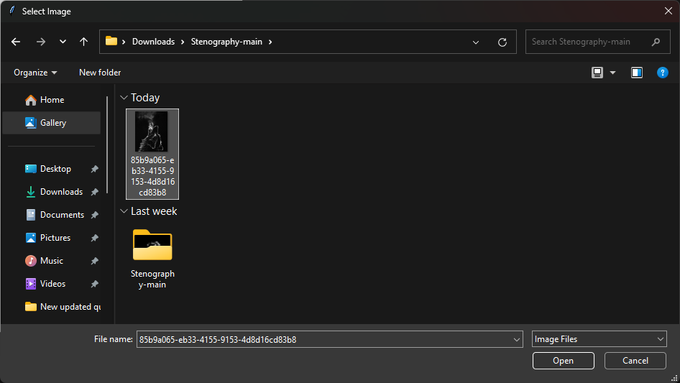
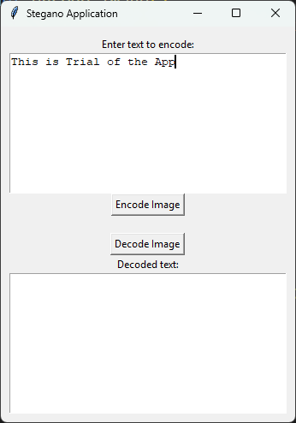
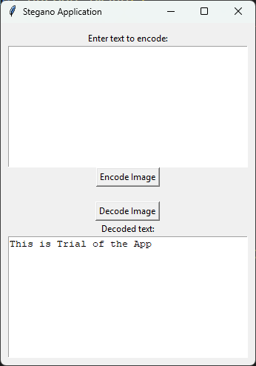
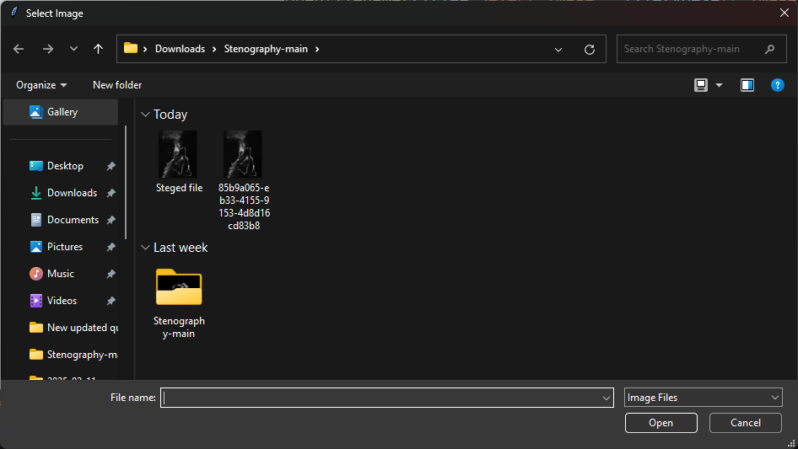
Results

Slide 8
Conclusion
This steganography project, grounded in the problem statement of ensuring secure and discreet communication in an increasingly digital world, addresses the vital need for privacy and data protection. In today’s technology growing world, where data breaches and unauthorized surveillance are rampant, the ability to hide sensitive information within ordinary media files provides an additional layer of security beyond traditional encryption methods.
Steganography is essential in contemporary times because it allows for the covert transfer of information without drawing attention. This capability is crucial for individuals and organizations operating under restrictive regimes, journalists safeguarding their sources, and any entity handling sensitive data. By embedding information invisibly within digital files, steganography complements encryption, making it significantly harder for adversaries to detect or extract confidential data.
In conclusion, the steganography project not only advances the field of secure communication but also empowers users with the tools to protect their privacy and maintain the integrity of their information. As digital communication continues to evolve, the importance of such technologies cannot be overstated, reinforcing the need for innovative and accessible solutions to address the challenges of modern data security.

Slide 9
GitHub Link
https://github.com/junejakapish/stegnoapp.git

Slide 10
THANK YOU

